Slide 1
OPENFLOW FLOW TABLE DELIVERY & LOAD BALANCING USING OPENDAYLIGHT, MININET, AND POSTMAN
Hao Fu Zhengyu Shen Yuheng Shi

Slide 2
What’s OpenFlow
Observing OpenFlow Messages in Wireshark
Project: Flow Table Delivery & Load Balancing

Slide 3
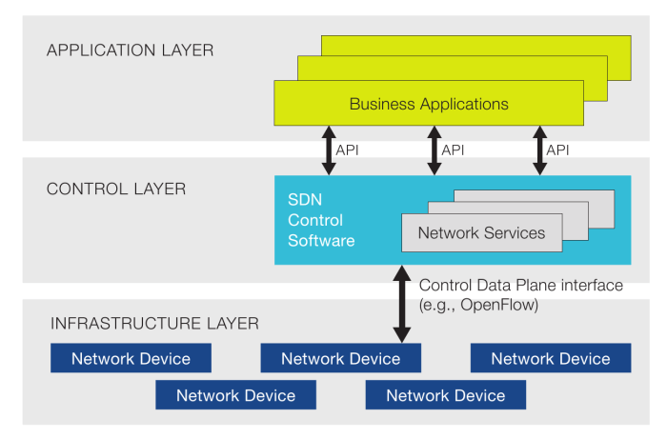
Separation
Control & Data Plane
OpenFlow

Slide 4
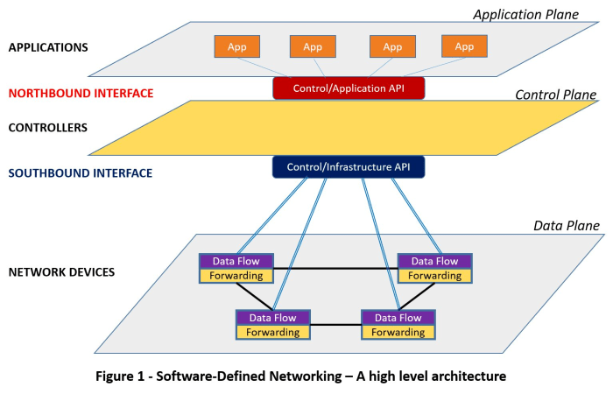
Network Abstraction
Direct Manipulation
Flow Tables/Entries

Slide 5
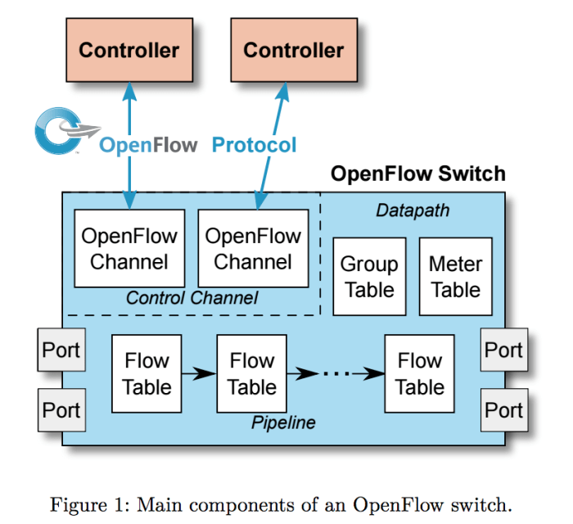
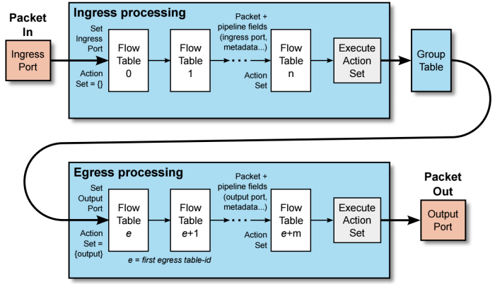
Components of an OpenFlow Switch
What if no match is found in a flow table?

Slide 6
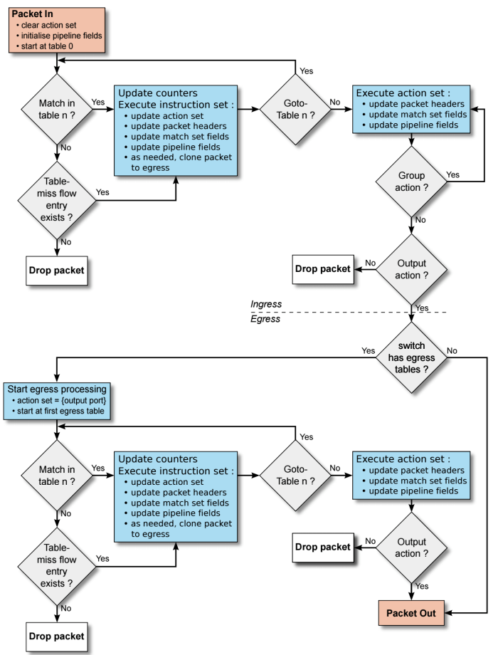
Table-miss Flow Entry
Catch-all
Forward the packet to the controller
Continue with the next flow table

Slide 7
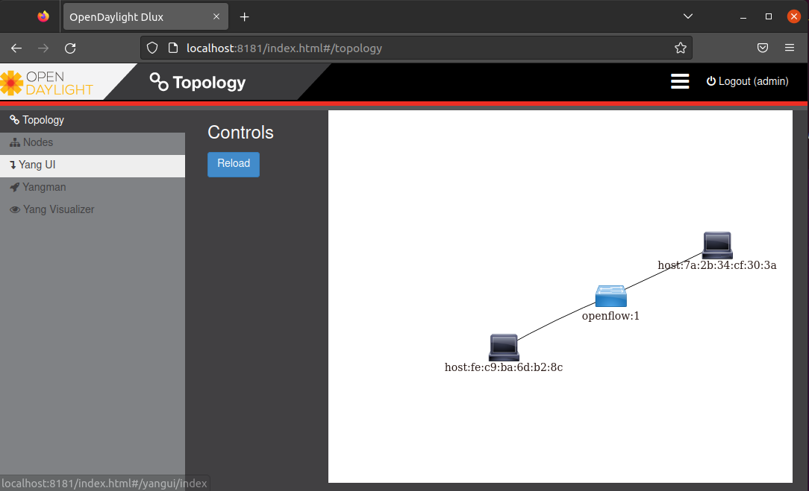
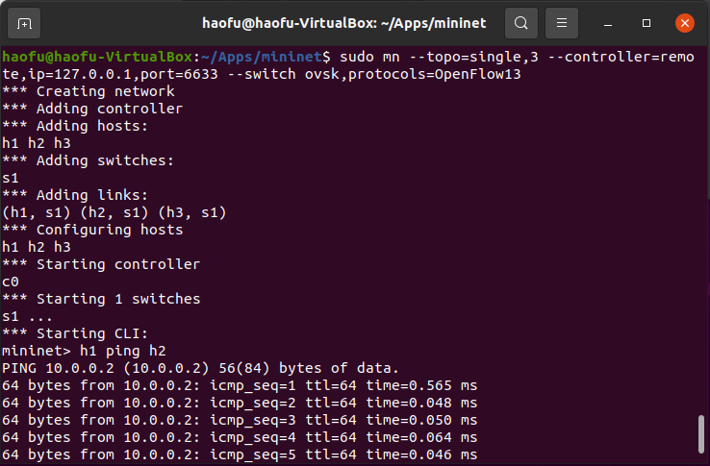
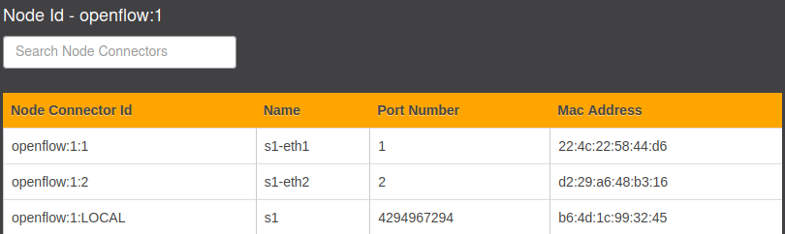
Observing OpenFlow Messages in Wireshark
Notes:
create the mininet topology and specify the use of OpenFlow
see this topology in the OpenDayLight controller
table shows the details of the h1, h2 and LOCAL management plane

Slide 8
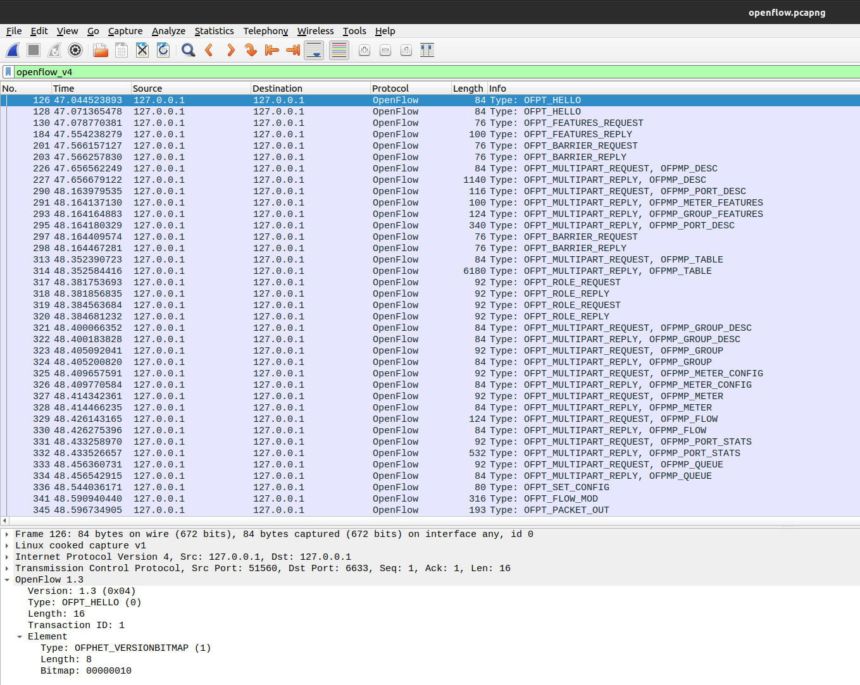
OPFT_HELLO
Notes:
This type of message is sent between the controller and the switch when they first establish their connection.
They contact with each other to find out their OpenFlow version.
They will choose a version that is compatible to both sides for later use.

Slide 9
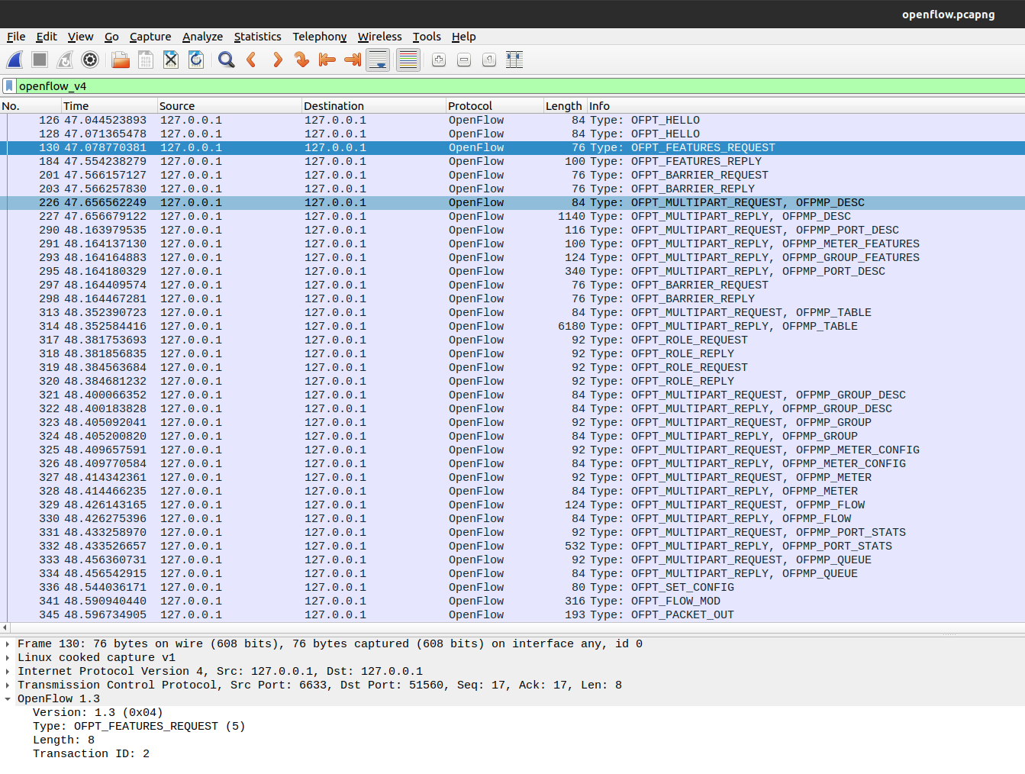
OPFT_FEATURES_REQUEST
Notes:
this type of message is sent from the controller to the switch.
As the name suggests, this kind of message is the controller asks switch to provide the feature information.
The feature information is about the the basic capabilities of the switch.

Slide 10
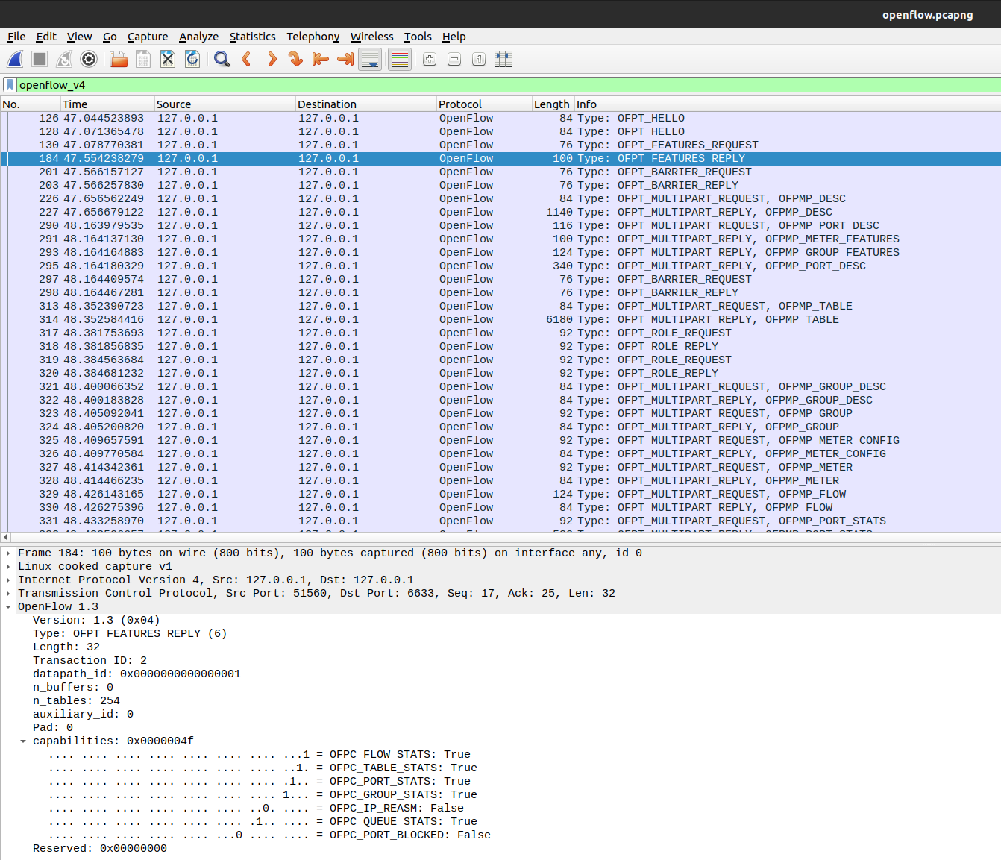
OPFT_FEATURES_REPLY
Notes:
The switch must respond with a features reply that specifies the basic capabilities of the switch.

Slide 11
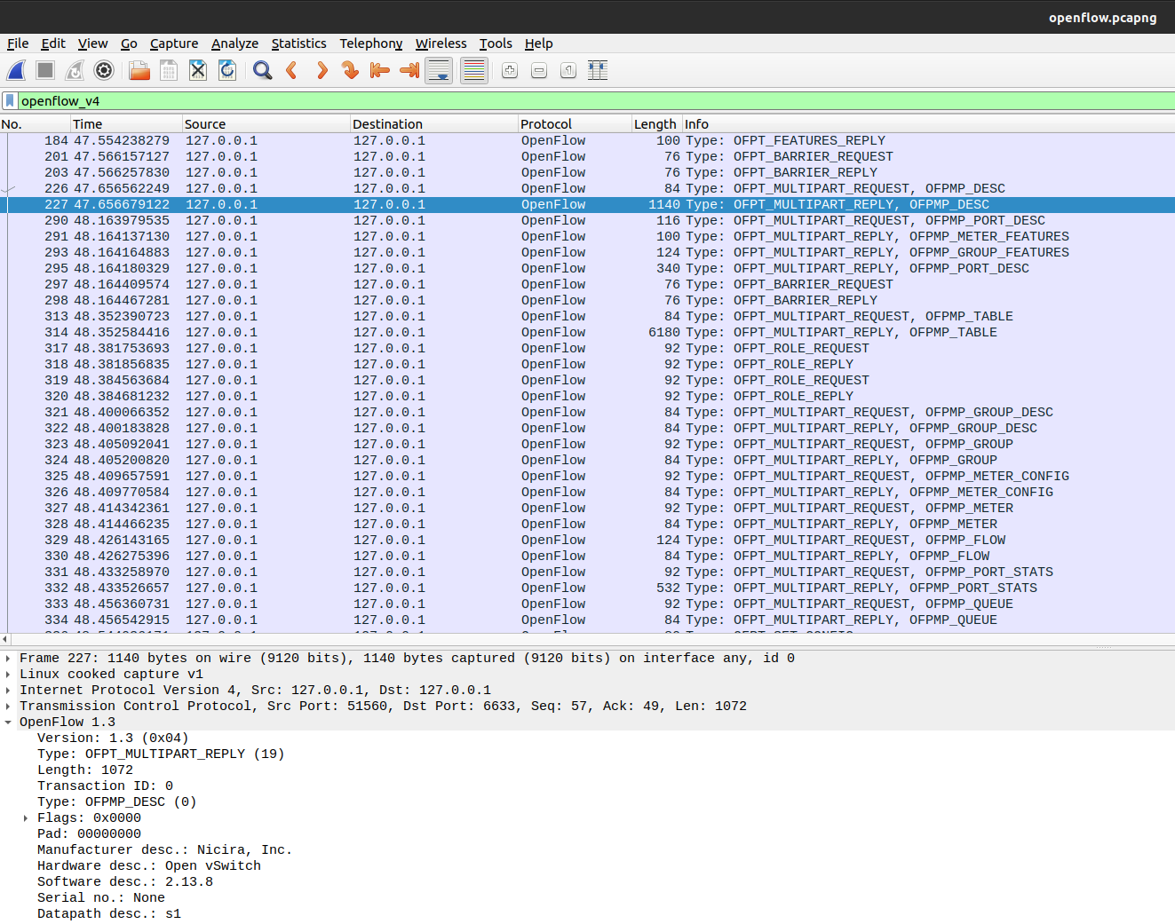
Multipart Request
Notes:
Another type of message that being sent from the controller to the switch.
ask about the long messages that cannot be sent in one single message.
this usually includes the attributes like the manufacturer information or hardware/sw versions.

Slide 12
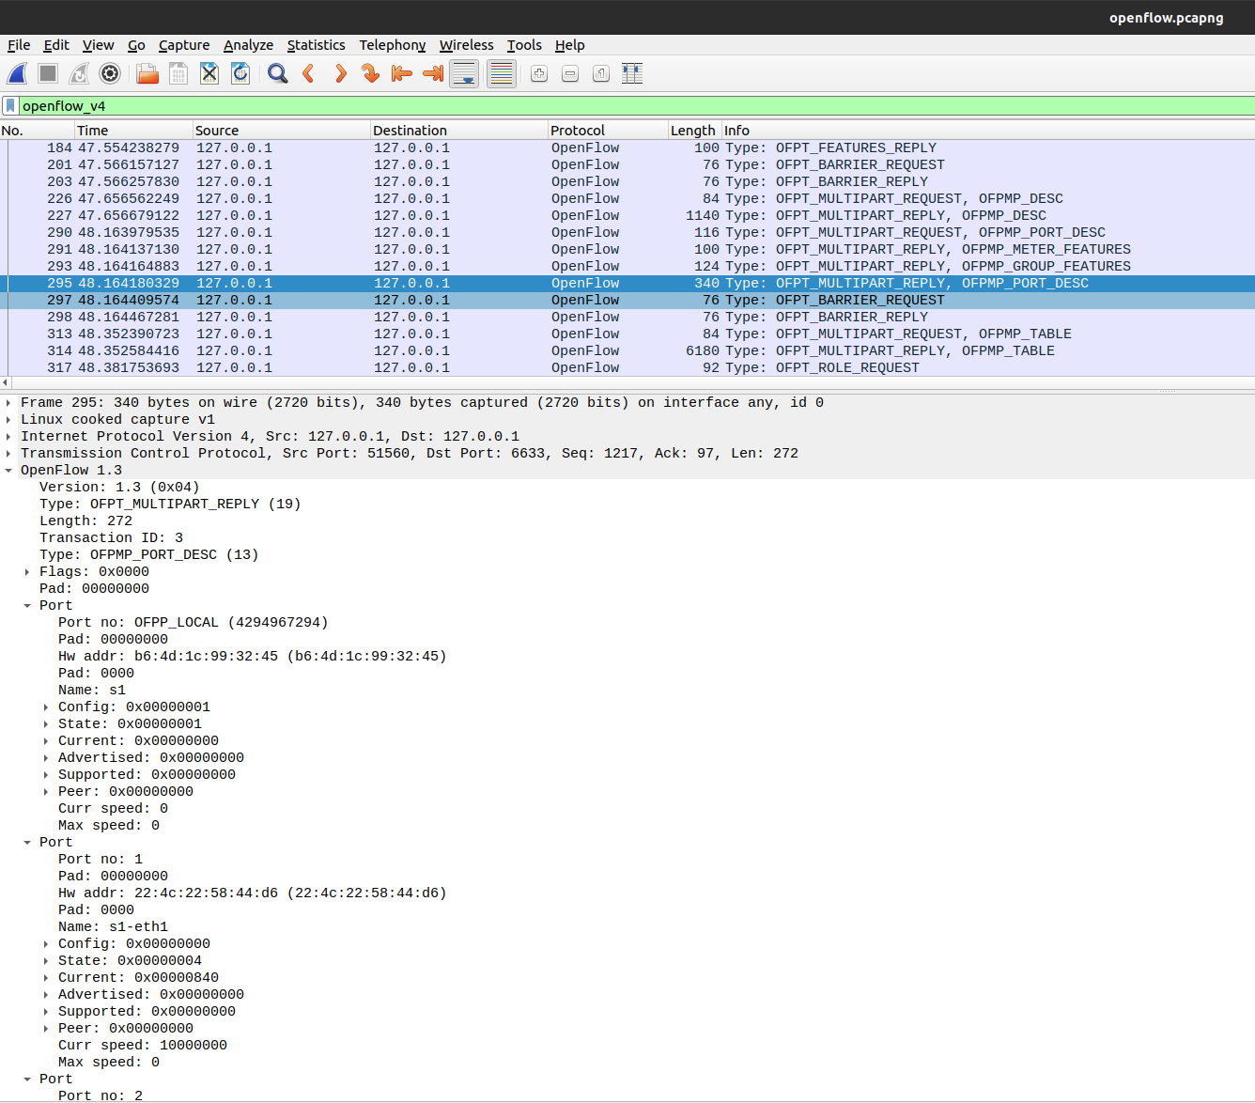
Multipart Reply
Notes:
port information about the controller
type, status, speed are all included.

Slide 13
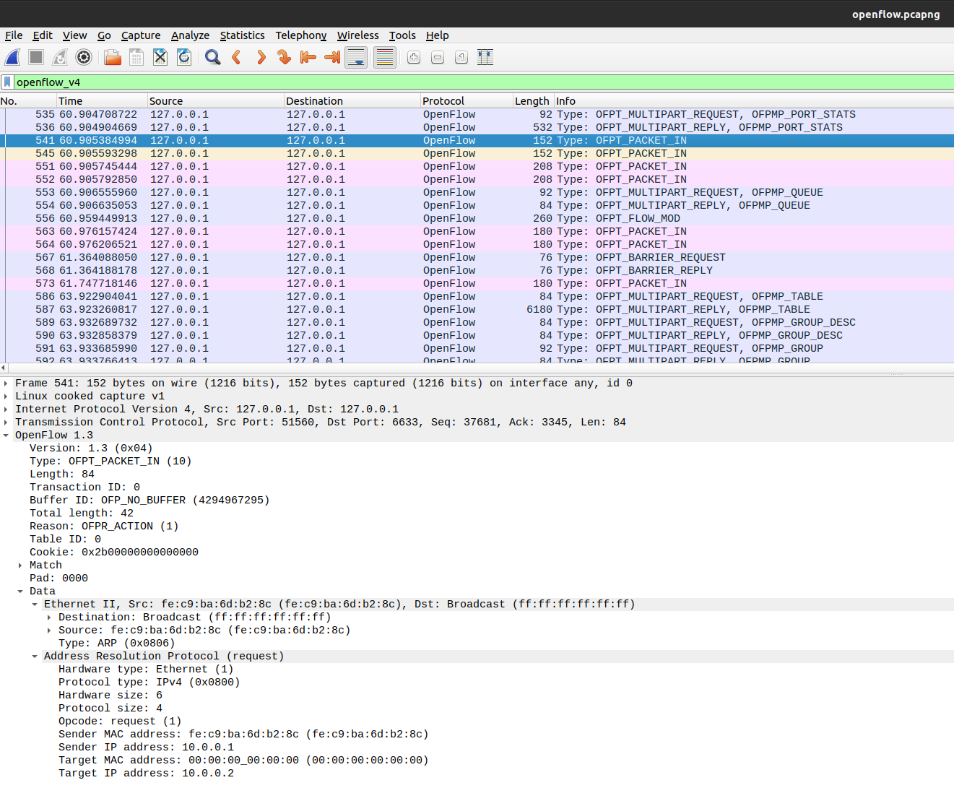
PACKET-IN and PACKET-OUT Messages
Notes:
sent from the switch to the controller, when h1 doesn’t know how to get to h2
This is a ARP (Address Resolution Protocol) message encapsulated by OpenFlow with TCP protocol

Slide 14
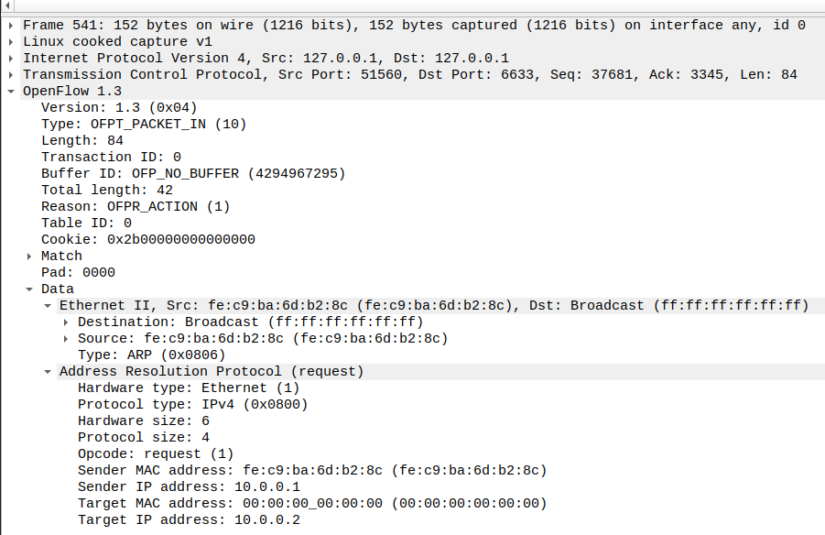
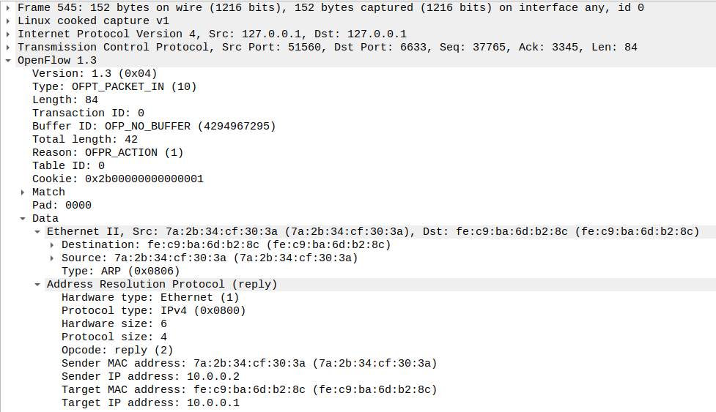
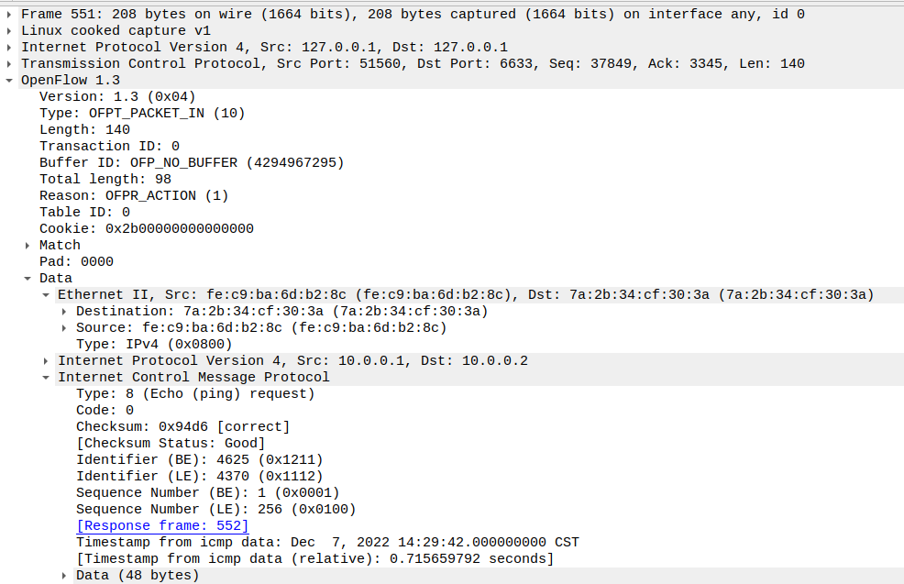
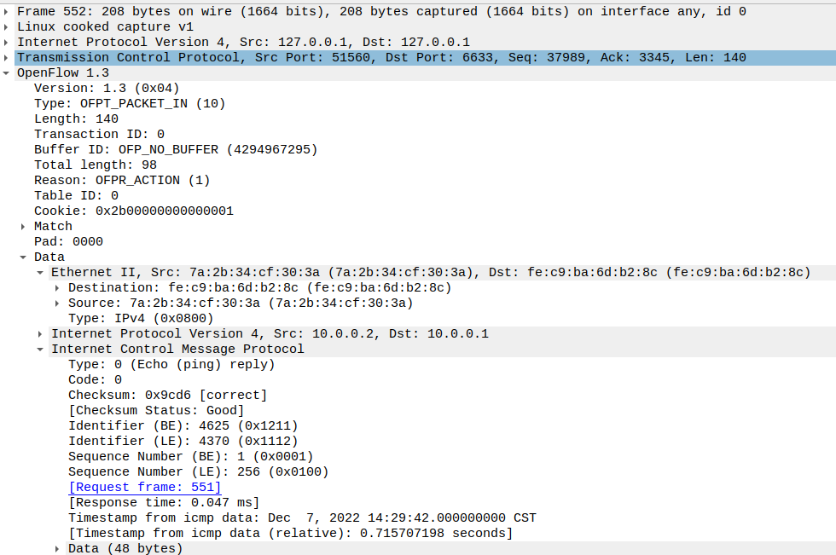
ARP Request
ARP Reply
ICMP Echo
Echo Reply
Notes:
PACKET OUT: ARP message from controller
Internet Control Message Protocol
those messages are known as ping message

Slide 15
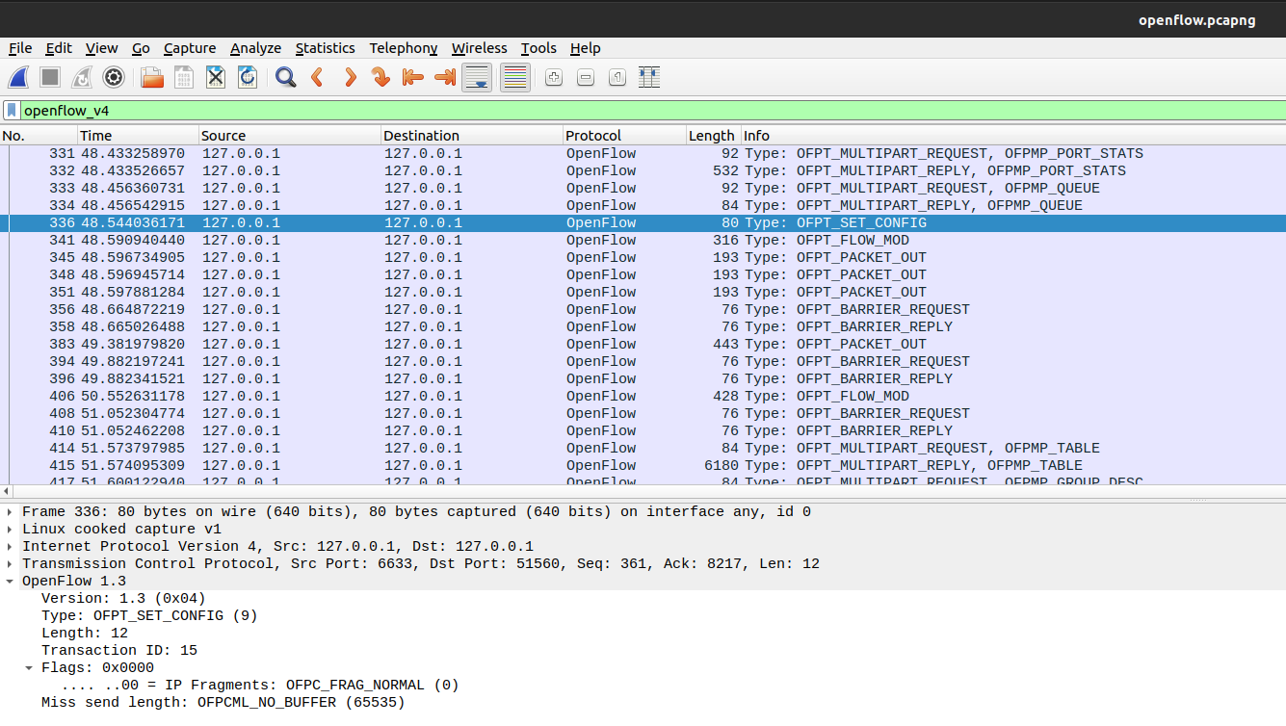
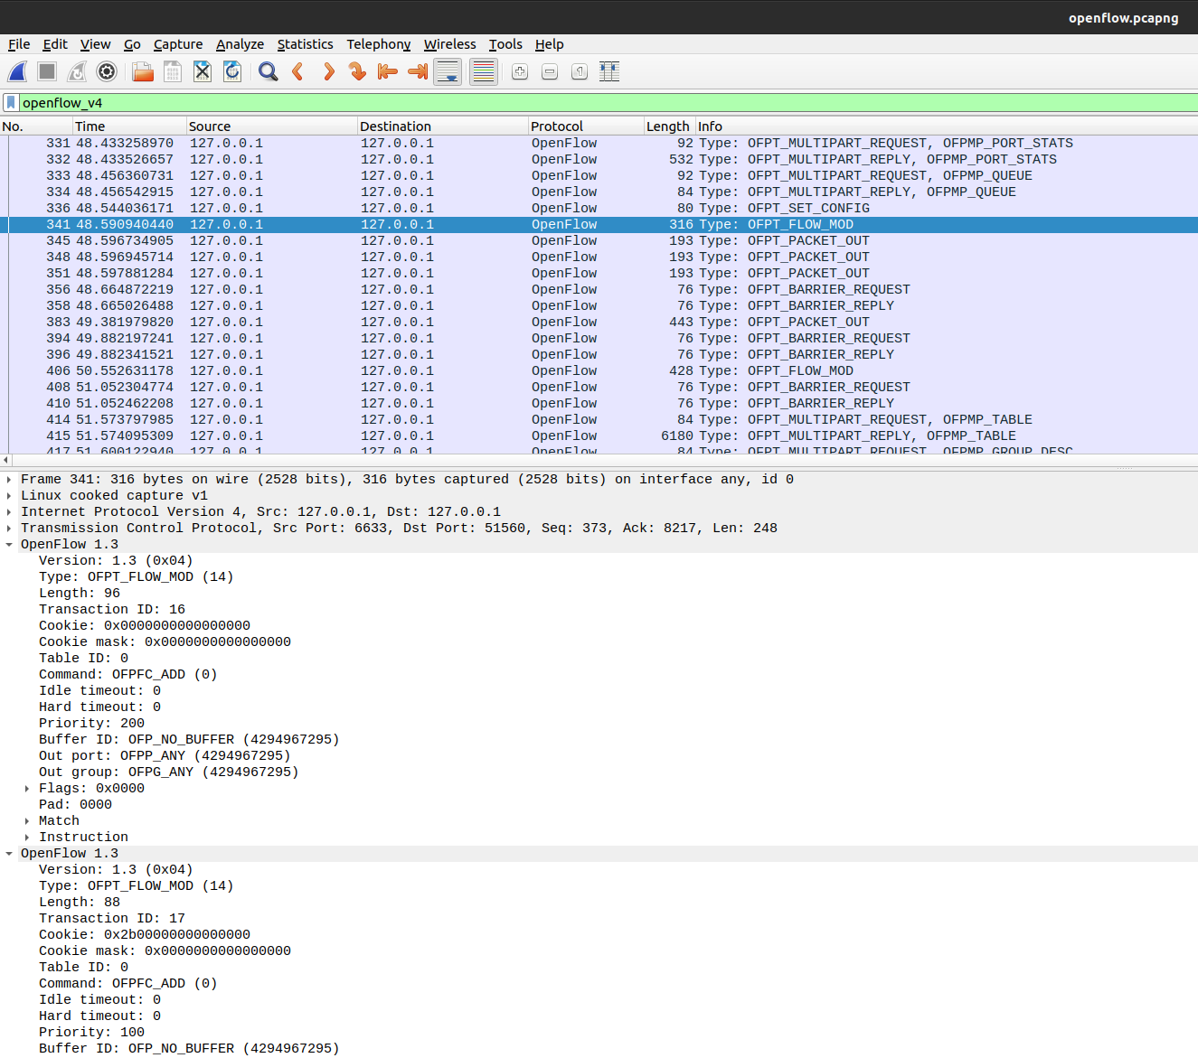
What’s more …
FLOW MOD
flow table
SET_CONFIG
Flags
Miss end length
Notes:
flow mod: similar to packet out, a message type from controller when they receive PACKET IN message
flow table: let switch know the MATCH and its ACTION.
Flag: how to handle IP fragmentation
Miss end length: max byte number that can send to the controller when encounter packets that cannot be handled.

Slide 16




Project: Flow Table Delivery & Load Balancing
Opendaylight
OSGi & Bundle
Karaf & Feature
Postman
Flow Table Delivery
Load Balancing

Slide 17
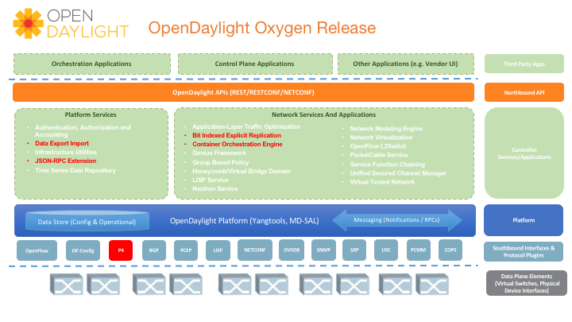
Introduces a P4 plug-in for the platform, increasing its value for key market segments, such as carriers and large cloud providers, who have embraced data plane abstraction.
The new BIER (Bit Indexed Explicit Replication) project introduces a method for multicast flow forwarding, without storing states in every node along the multicast path.
Begins the move to a “managed distribution” model, which decouples non-core projects from the main release process and allows them to evolve at their own pace.
What’s New?
Hydrogen, Helium, … , Oxygen, … , Chlorine

Slide 18
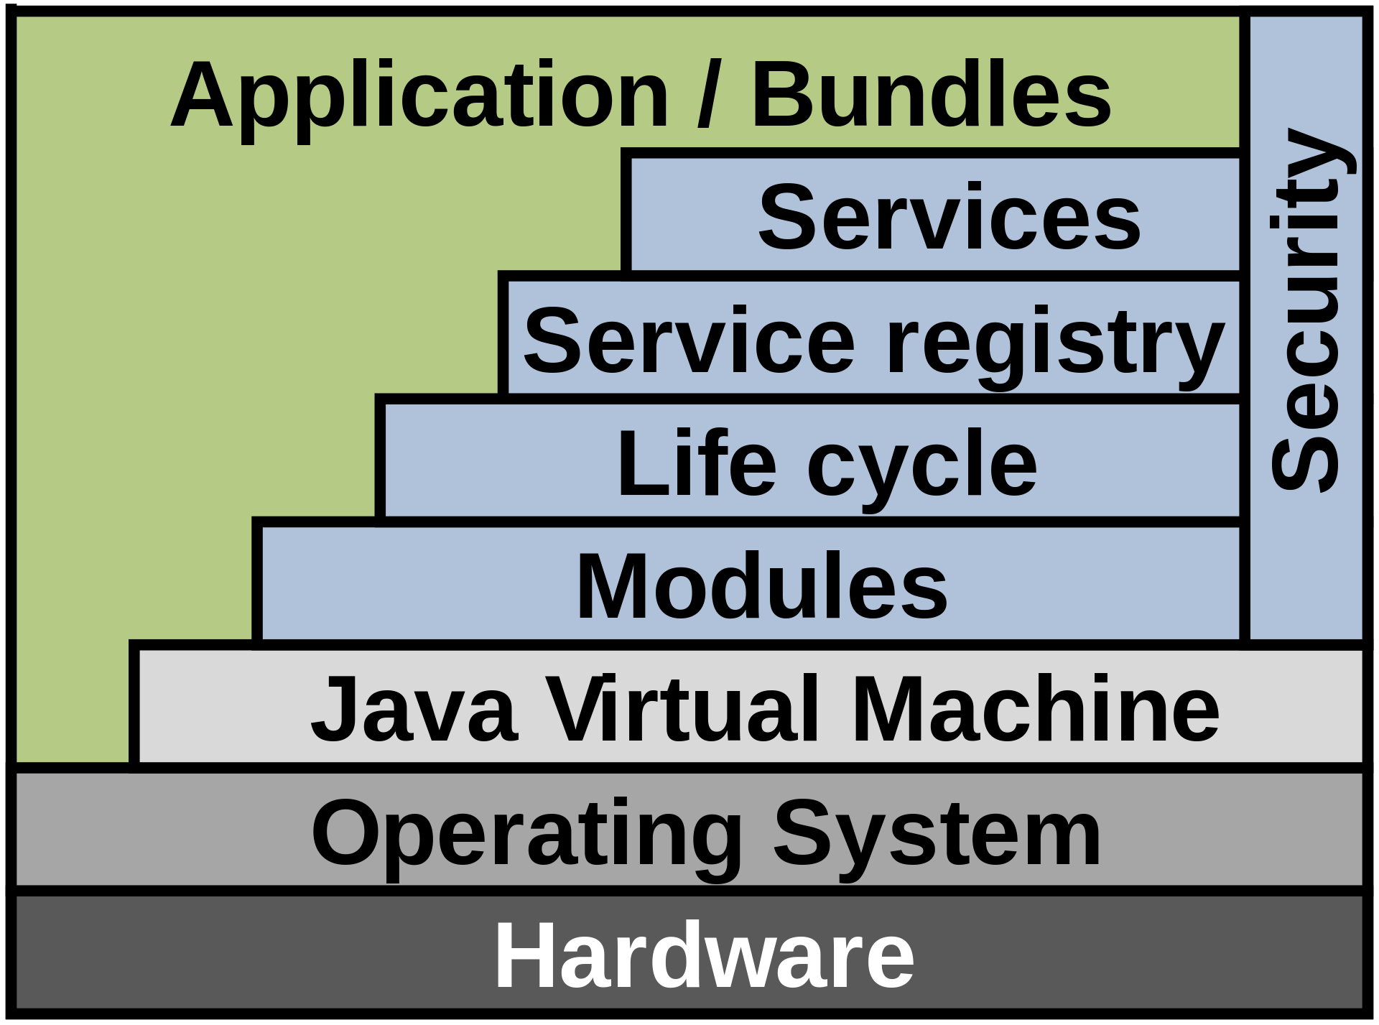
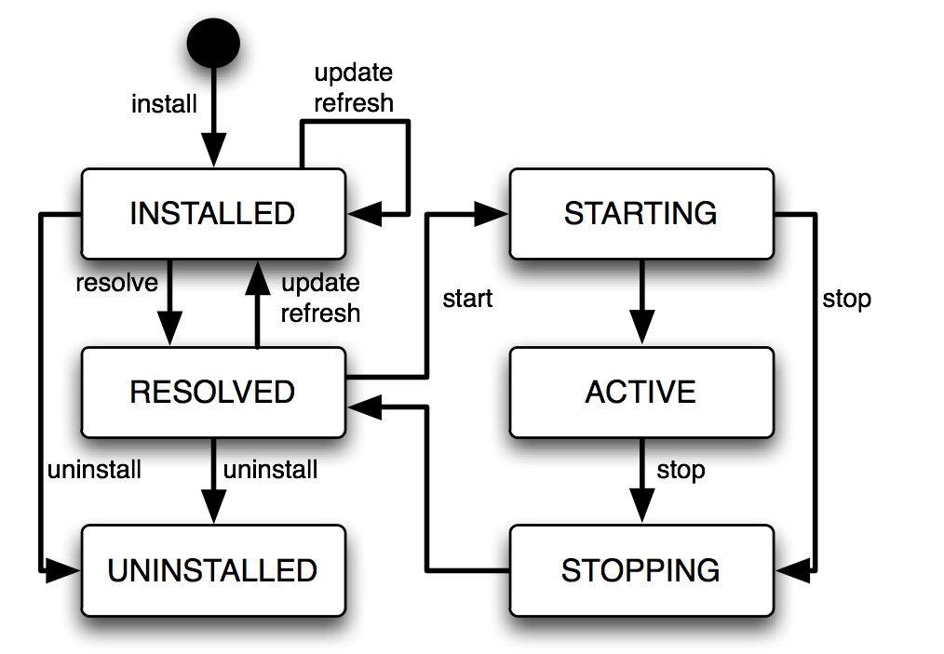
INSTALLED - The bundle has been installed into the OSGi container, but some of the bundle's dependencies have not yet been met. The bundle requires packages that have not been exported by any currently installed bundle.
RESOLVED - The bundle is installed, and the OSGi system has connected up all the dependencies at a class level and made sure they are all resolved. The bundle is ready to be started. If a bundle is started and all of the bundle's dependencies are met, the bundle skips this state.
STARTING - A temporary state that the bundle goes through while the bundle is starting, after all dependencies have been resolved.
ACTIVE - The bundle is running. Disabled while Spring is doing its stuff. Spring scans the Spring configuration and builds the context, then hands the context to the plugin. The plugin needs the context in order to create instances of each plugin module.
STOPPING - A temporary state that the bundle goes through while the bundle is stopping.
UNINSTALLED - The bundle has been removed from the OSGi container.

Slide 19
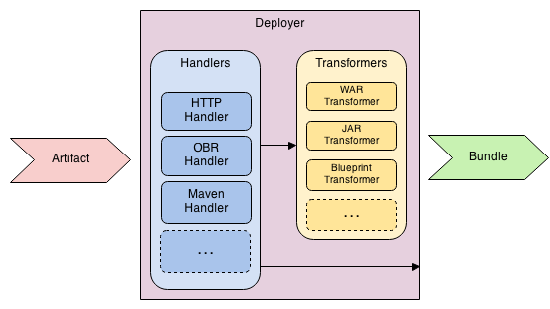
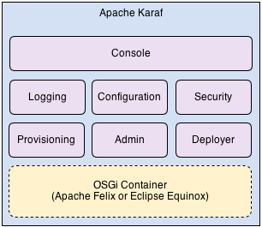
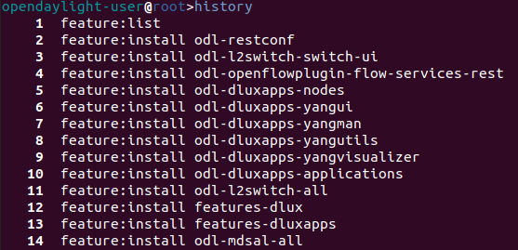
Apache Karaf from 10k feet
Artifact Deployment Process
Hot Deployment, Dynamic Configuration, Logging System, Provisioning, Shell Console, Remote Management, WebConsole, Security, INstances Management, Docker & Cloud Ready

Slide 20
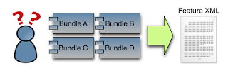
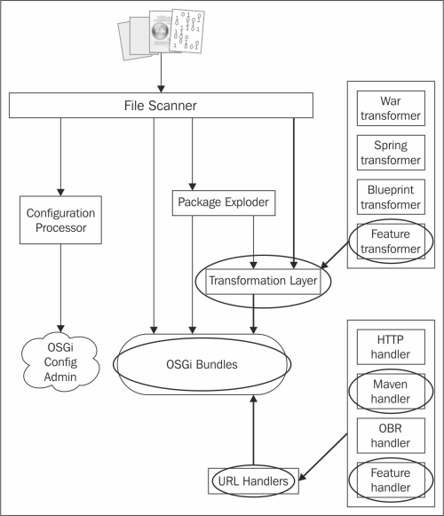
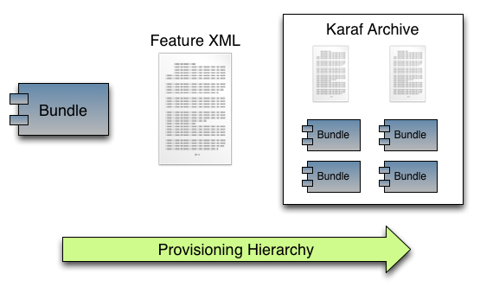
How can we simplify provisioning bundles?
We use Feature XML files!

Slide 21
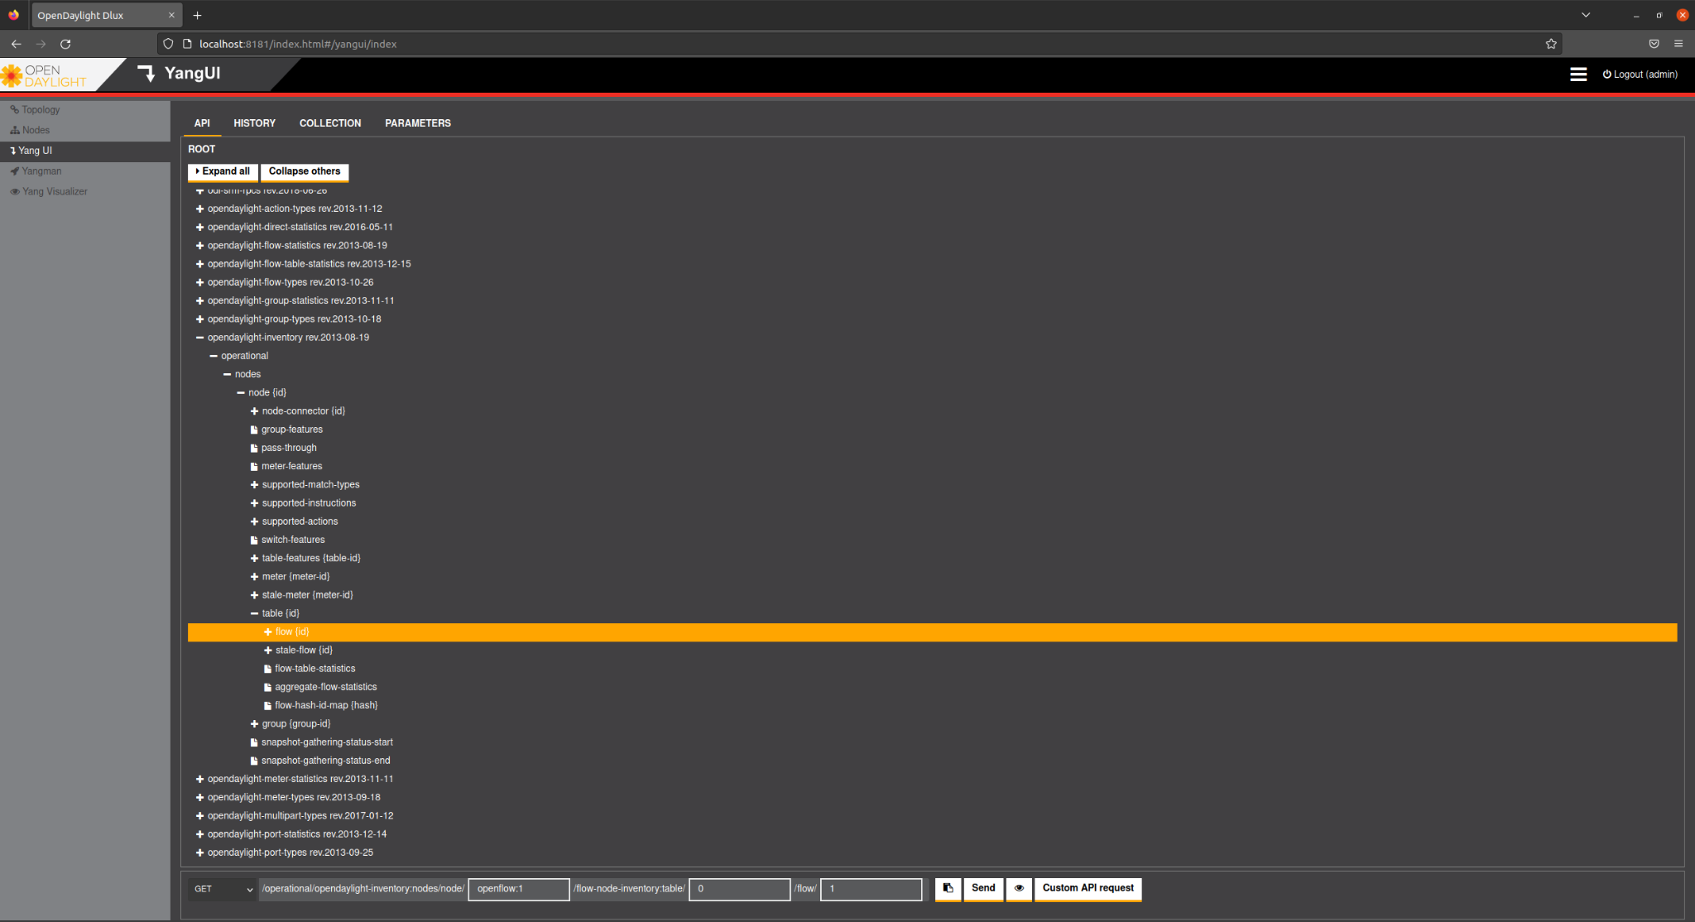
Yang UI (*)

Slide 22
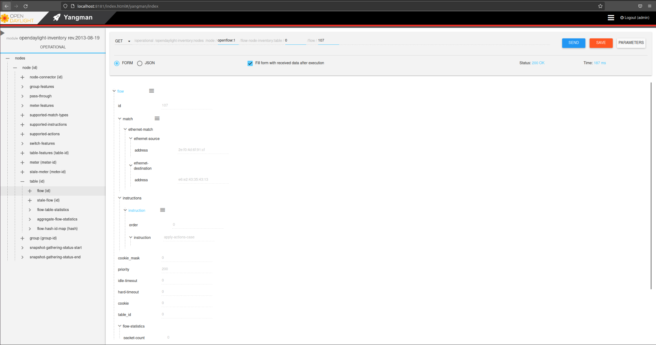
Yangman - (Postman)

Slide 23
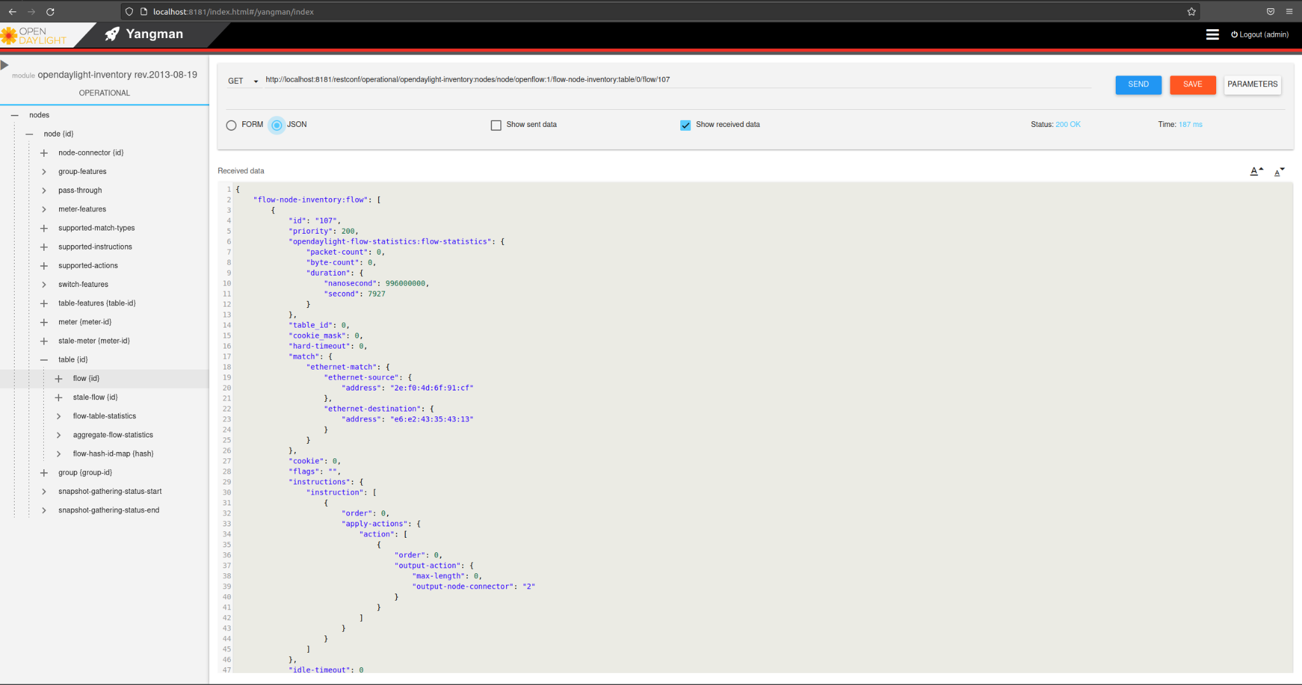

Slide 24
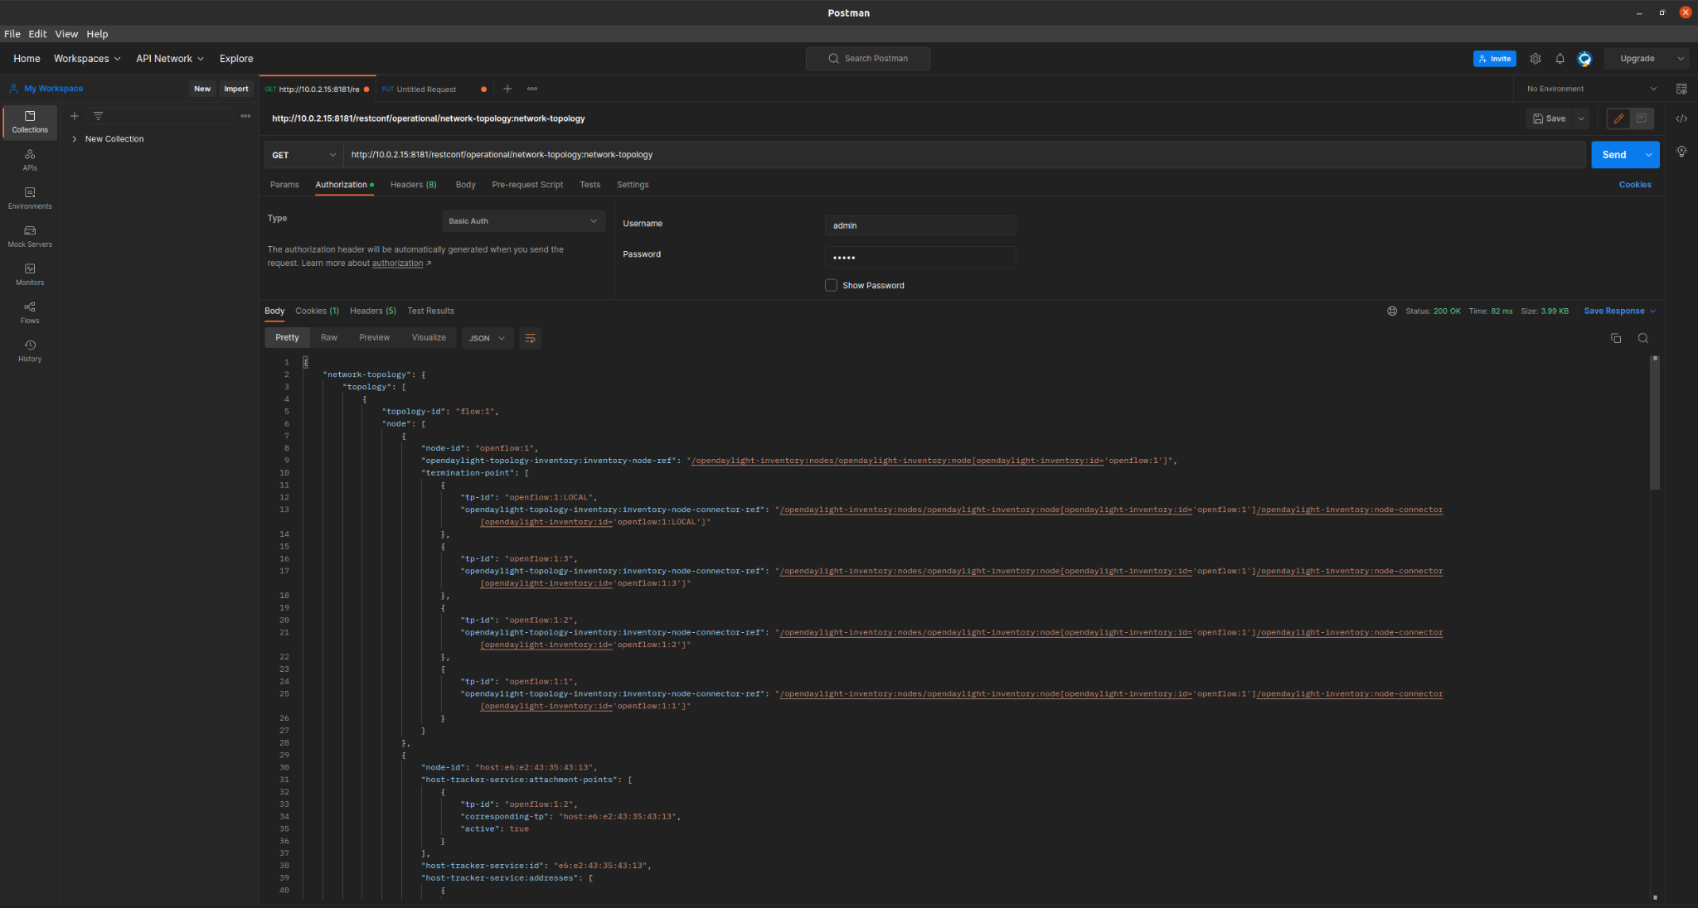
Postman

Slide 25
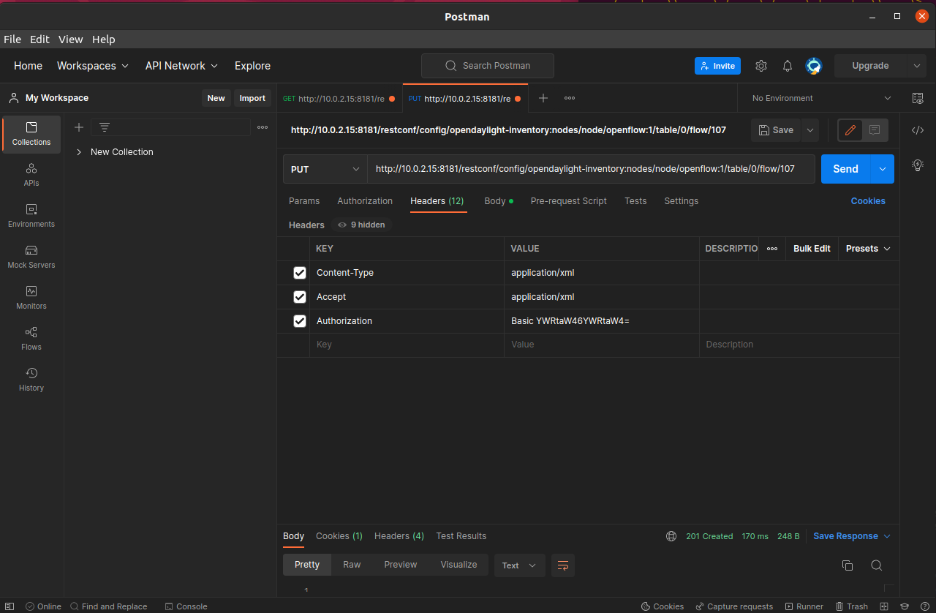
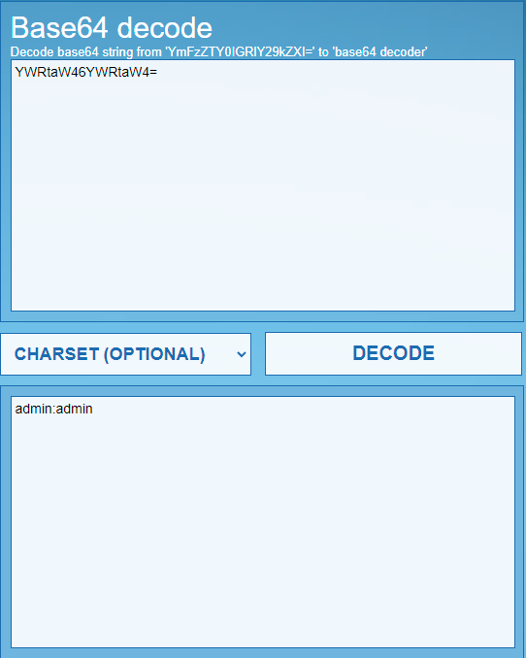

Slide 26
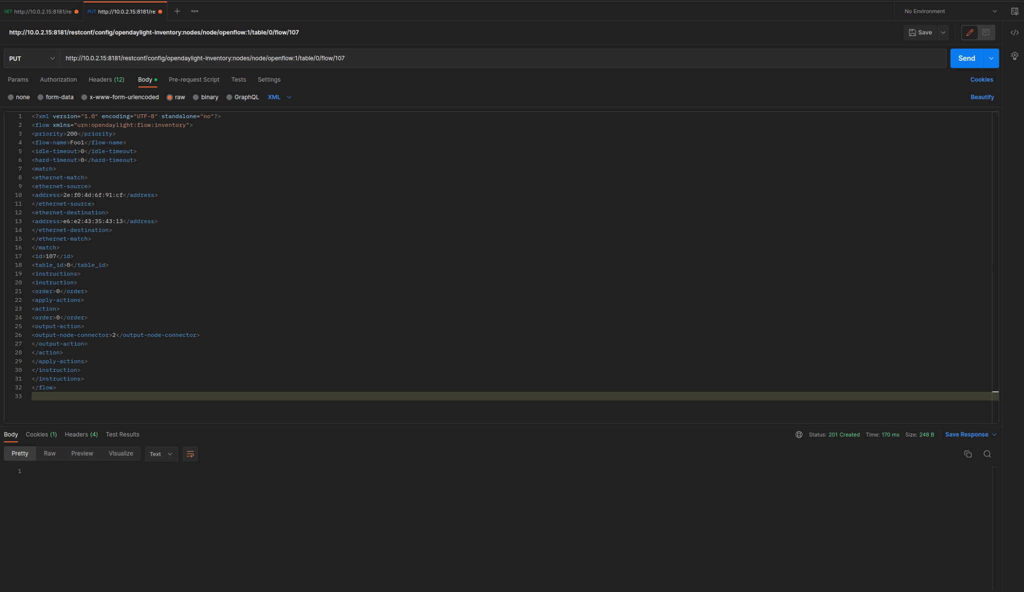

Slide 27
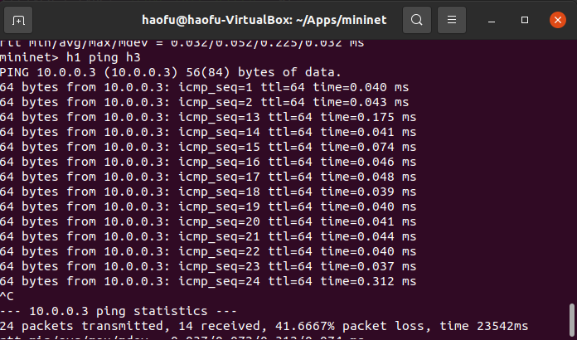
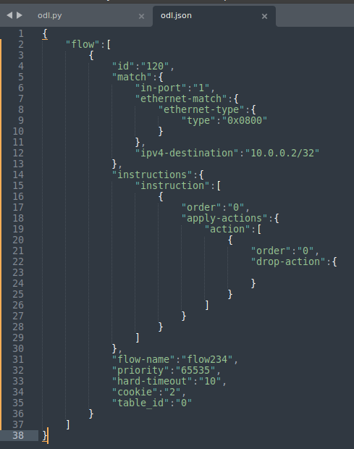
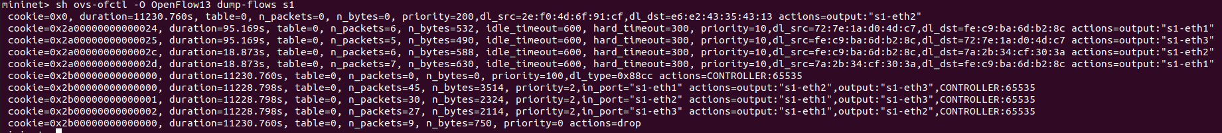

Slide 28
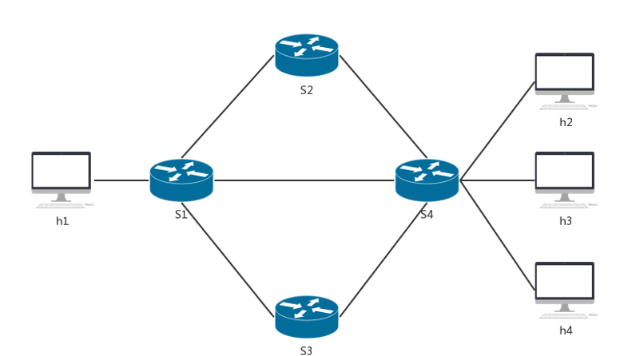
What’s More: Load Balancing
Create Mininet topology with Python ✔
Use Postman to deliver some flow tables, make sure S2 and S3 are “link pass” ✘
Use Python to achieve load balancing between “h2 & h1”, “h3 & h1”, and “h4 & h1” ★
“iperf” to test the TCP bandwidth between hosts

Slide 29
Thank you!

